Slide 1
Artificial Intelligence Lecture No. 7

Slide 2
Summary of Previous Lecture
Problem solving by searching
What is Search?
Problem formulation
Search Space Definitions
Goal-formulation
Searching for Solutions Visualize Search Space as a Graphs

Slide 3
Today’s Lecture
Types of search Algorithms
Uninformed Search
Informed Search
Breadth-first searching
Depth-first search
Compare breadth first and depth first

Slide 4
Today’s Lecture
Types of search Algorithms
Uninformed Search
Informed Search
Breadth-first searching
Depth-first search

Slide 5
Two main types of search
All search strategies are distinguished by the Order in which nodes are expanded
Uninformed search methods (Blind search) have access only to the problem definition.
Breadth-first search
Uniform-cost search
Depth-first search
Iterative deepening search
Bidirectional search
Informed search methods may have access to a heuristic function h(n) that estimate the cost of a solution from n.
Greedy best-first search
A* search
Recursive best-first search (RBFS) search

Slide 6
Uninformed Search
Sometimes we may not get much relevant information to solve a problem.
Suppose we lost our car key and we are not able to recall where we left, we have to search for the key with some information such as in which places we used to place it. It may be our pant pocket or may be the table drawer. If it is not there then we have to search the whole house to get it. The best solution would be to search in the places from the table to the wardrobe. Here we need to search blindly with less clue.
This type of search is called uninformed search or blind search.

Slide 7
Uninformed Search and Exploration
Blind search – BFS, DFS, uniform cost
no notion concept of the “right direction”
can only recognize goal once it’s achieved

Slide 8
Informed Search
We can solve the problem in an efficient manner if we have relevant information, clues or hints. The clues that help solve the problem constitute heuristic information.
Informed search is also called heuristic search.
Instead of searching one path or many paths just like that informed search uses the given heuristic information to decide whether or not to explore the current state further.

Slide 9
Informed Search
Add domain-specific information to select the best path along which to continue searching
Define a heuristic function, h(n), that estimates the “goodness” of a node n.
Specifically, h(n) = estimated cost (or distance) of minimal cost path from n to a goal state.
The heuristic function is an estimate, based on domain-specific information that is computable from the current state description, of how close we are to a goal

Slide 10
Breadth-first search
Breadth first search (BFS), as the name implies, searches from the initial state breadth-wise.
That is it searches all the states in the tree level by level.
Only after exploring all the states in one level it will jump to the next level.
Once the solution is found the search stops.
The breadth first search is guaranteed to find the solution if one exists.

Slide 11
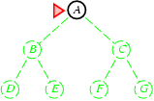
Breadth-first search
Expand shallowest unexpanded node
Implementation:

Slide 12
Breadth-first search
Expand shallowest unexpanded node
Implementation:

Slide 13
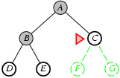
Breadth-first search
Expand shallowest unexpanded node
Implementation:

Slide 14
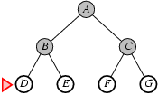
Breadth-first search
Expand shallowest unexpanded node

Slide 15
Breadth-first searching
A breadth-first search (BFS) explores nodes nearest the root before exploring nodes further away
For example, after searching A, then B, then C, the search proceeds with D, E, F, G
Node are explored in the order A B C D E F G H I J K L M N O P Q
J will be found before N
A
B
C
D
E
F
G
H
I
J
K
L
M
N
O
P
Q

Slide 16
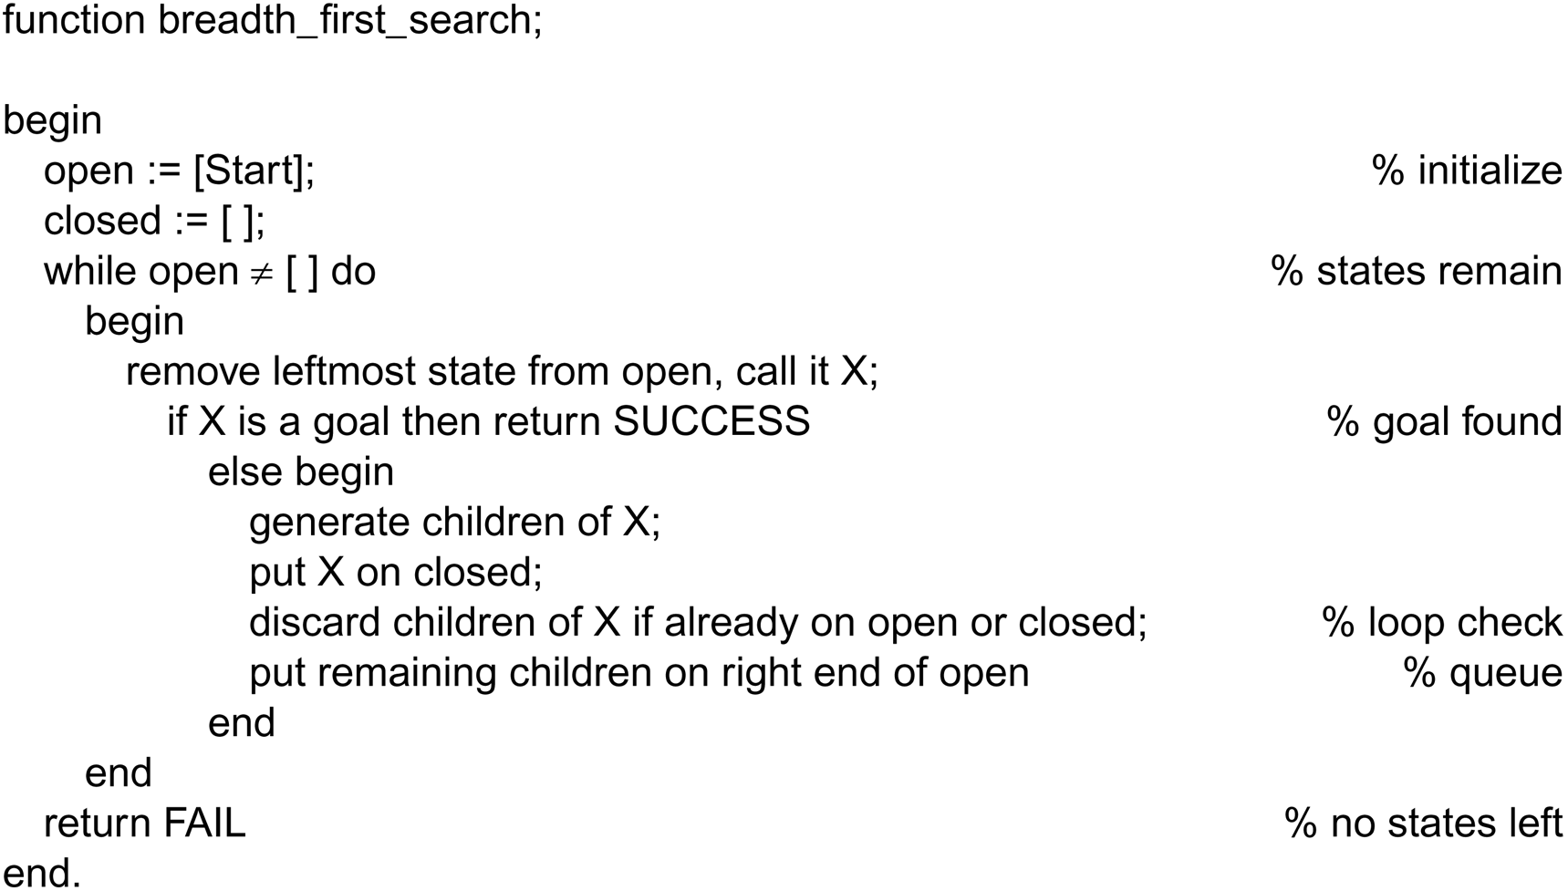
Breadth-first search algorithm
Nodes are lining up to be visited in open. closed keeps track of all the nodes visited already.

Slide 17
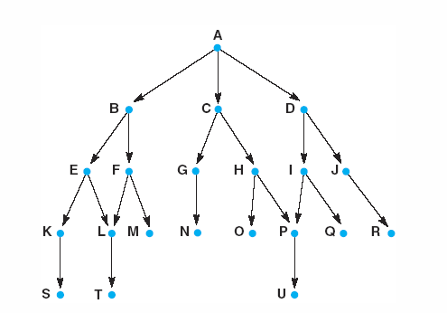
A trace of
breadth-first algorithm
B is not the goal. Put his children onto the queue. Put him in closed. He is done.
|
|
|
Items between red bars are siblings.
|
|
|
|
|
|
|
|
|
|
|
|
goal is reached or open is empty.

Slide 18
Properties of breadth-first search
Complete? Yes (if b is finite)
Time? 1+b+b²+b³+… +b^{d} + b(b^{d}-1) = O(b^{d+1})
Space? O(b^{d+1}) (keeps every node in memory)
Optimal? Yes (if cost = 1 per step)
Space is the bigger problem (more than time)

Slide 19
Breadth-first search tree sample
Branching factor: number of nodes generated by a node parent (we called here “b”)
➔ Here after b=2
0 expansion
1 expansion
2 expansions
3 expansions

Slide 20
Breadth First Complexity
The root ➔ generates (b) new nodes
Each of which ➔ generates (b) more nodes
So, the maximum number of nodes expended before finding a solution at level “d”, it is :
1+b+b²+b³+….+b^{d}
Complexity is exponential = O(b^{d})

Slide 21
Time and memory requirement in Breadth-first
Depth | Nodes | Time | Memory
0 | 1 | 1 millisec | 100 bytes
2 | 111 | .1 sec | 11 Kb
4 | 11.111 | 11 sec | 1 Mb
6 | 10⁶ | 18 minutes | 111 Mb
8 | 10⁸ | 31 hours | 11 Gb
10 | 10¹⁰ | 128 days | 1 Tb
12 | 10¹² | 35 years | 111 Tb
14 | 10¹⁴ | 3500 years | 11.111 Tb
Assume branching factor b=10; 1000 nodes explored/sec and 100 bytes/node

Slide 22
Depth-first search
Explore only one branch deeper till the solution is found or there is no new state to explore and then start searching the adjacent level.
This technique is called depth first searh (DFS).
By chance the solution exists in the first branch then depth first search can find the solution quickly.
If the solution exists in some other branches farther away, there won't be much difference between depth first search and breadth first search

Slide 23
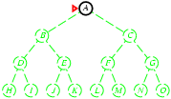
Depth-first search
Expand deepest unexpanded node
Implementation:

Slide 24
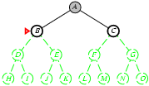
Depth-first search
Expand deepest unexpanded node
Implementation:

Slide 25
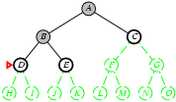
Depth-first search
Expand deepest unexpanded node
Implementation:

Slide 26
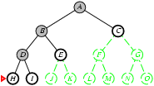
Depth-first search
Expand deepest unexpanded node
Implementation:

Slide 27
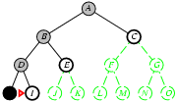
Depth-first search
Expand deepest unexpanded node
Implementation:

Slide 28
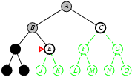
Depth-first search
Expand deepest unexpanded node
Implementation:

Slide 29
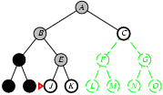
Depth-first search
Expand deepest unexpanded node
Implementation:

Slide 30
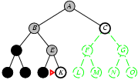
Depth-first search
Expand deepest unexpanded node
Implementation:

Slide 31
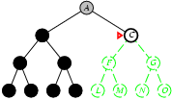
Depth-first search
Expand deepest unexpanded node
Implementation:

Slide 32
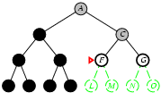
Depth-first search
Expand deepest unexpanded node
Implementation:

Slide 33
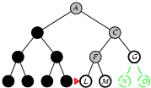
Depth-first search
Expand deepest unexpanded node
Implementation:

Slide 34
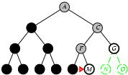
Depth-first search
Expand deepest unexpanded node
Implementation:

Slide 35
Depth-first searching
A depth-first search (DFS) explores a path all the way to a leaf before backtracking and exploring another path
For example, after searching A, then B, then D, the search backtracks and tries another path from B
Node are explored in the order A B D E H L M N I O P C F G J K Q
N will be found before J
A
B
C
D
E
F
G
H
I
J
K
L
M
N
O
P
Q

Slide 36
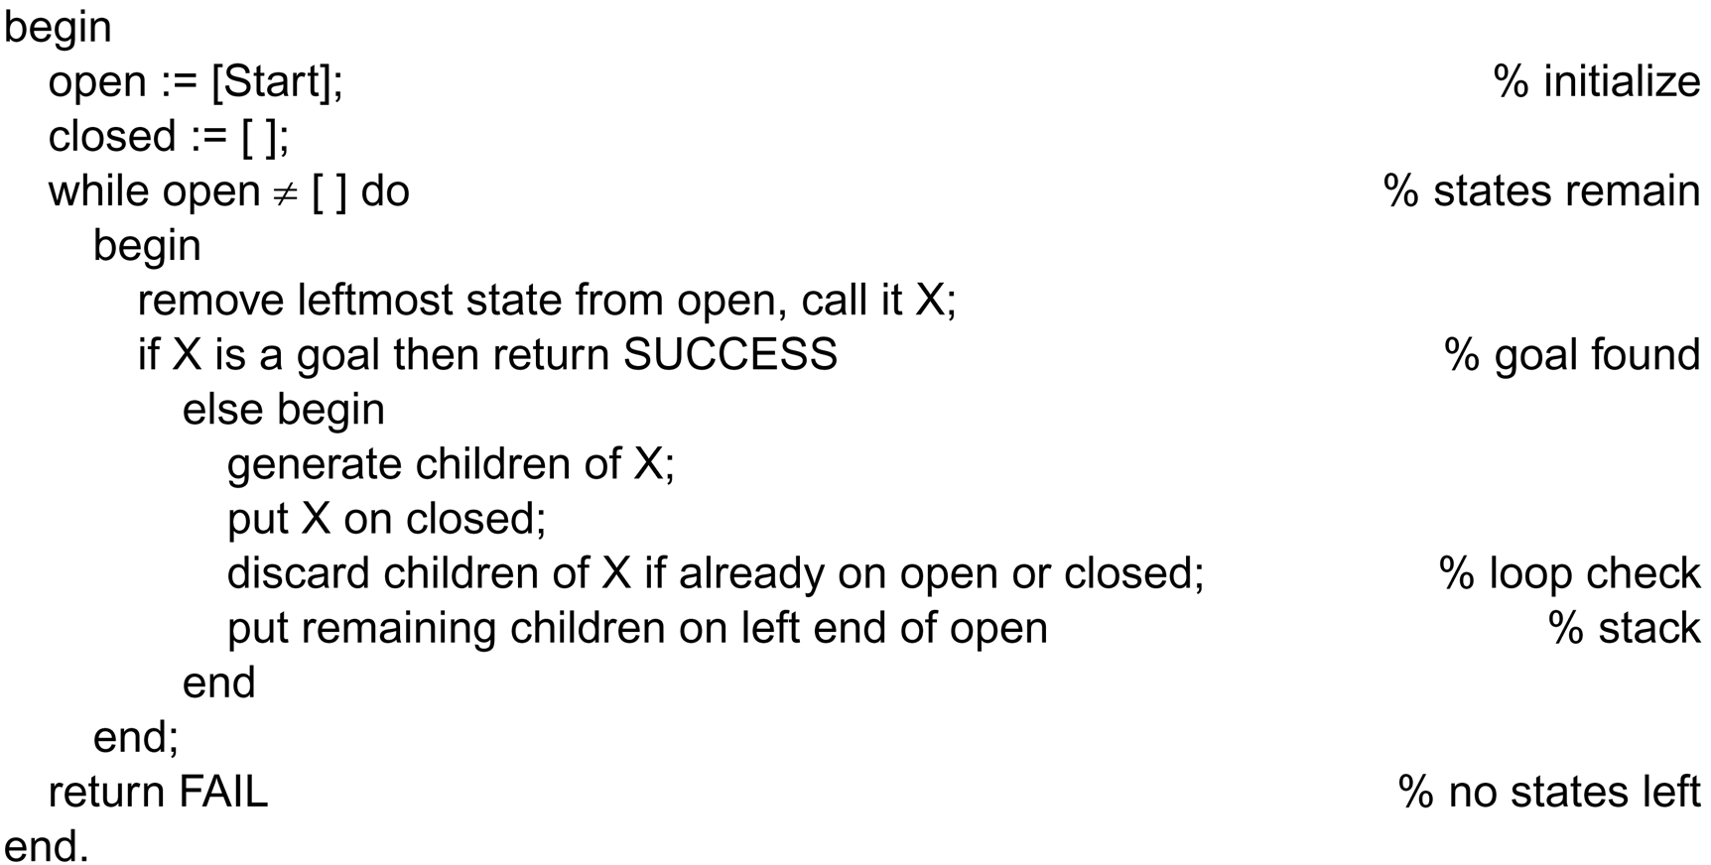
The depth-first search algorithm
This is the only difference between
depth-first and breadth-first.

Slide 37
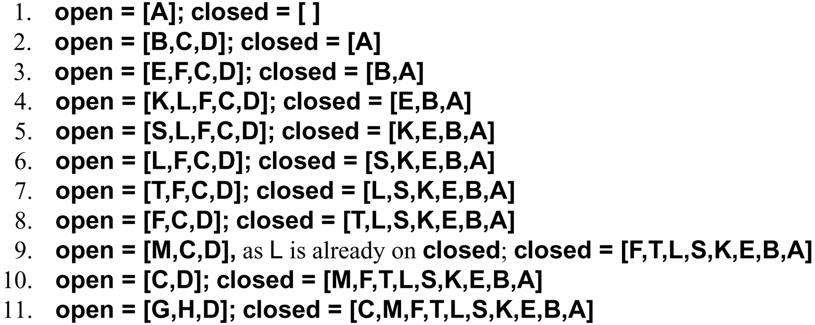
A trace of
depth-first algorithm
top of stack

Slide 38
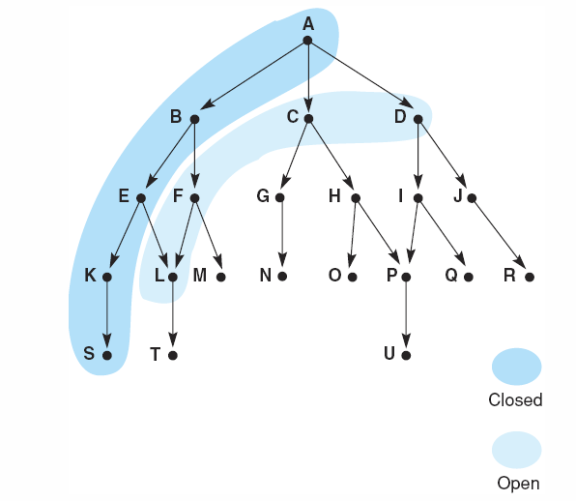
Snap shot at iteration 6
frontier
visited

Slide 39
Properties of depth-first search
Complete? No: fails in infinite-depth spaces, spaces with loops
Modify to avoid repeated states along path
→ complete in finite spaces
Time? O(b^{m}): terrible if m is much larger than d
but if solutions are dense, may be much faster than breadth-first
Space? O(bm), i.e., linear space!
Optimal? No

Slide 40
Depth-first search tree sample
Branching factor: number of nodes generated by a node parent (we called here “b”)
➔ Here after b=2
0 expansion
1 expansion
2 expansions
4 expansions

Slide 41
Depth First Complexity
Let b: is the branching factor
Let d: maximum depth to find solution
So, the maximum number of nodes expended before finding a solution at level “m”, it is :
1+b+b+b+….+b (m times)
Memory need = b*d
Complexity in worst case = O(b^{d}) as “Breadth-First”
Complexity in best case = O(b*d) which is excellent!

Slide 42
Time and memory requirement in Depth-first
Depth | Nodes | Time (best case) | Memory
0 | 1 | 1 millisec | 100 bytes
2 | 20 | 0.02 sec | 2 Kb
4 | 40 | 0.04 sec | 4 Kb
6 | 10 * 6 | 0.06 sec | 6 Kb
8 | 10 * 8 | 0.08 sec | 8 Kb
10 | 10 *10 | 0.1 sec | 10 Kb
12 | 10 * 12 | 0.12 sec | 12 Kb
14 | 10 * 14 | 0.14 sec | 14 Kb
Assume branching factor b=10; 1000 nodes explored/sec and 100 bytes/node

Slide 43
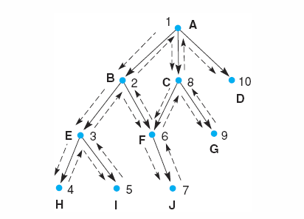
Search sequences of depth-first and breadth-first
Breadth first: A, B, C, …
Depth first: 1, 2, 3, …
Notes:
Insert fig 3.15

Slide 44
Comparing the ordering of search sequences
Determine the order of nodes (states) to be examined
Breadth-first search
When a state is examined, all of its children are examined, one after another
Explore the search space in a level-by-level fashion
Depth-first search
When a state is examined, all of its children and their descendants are examined before any of its siblings
Go deeper into the search space where possible

Slide 45
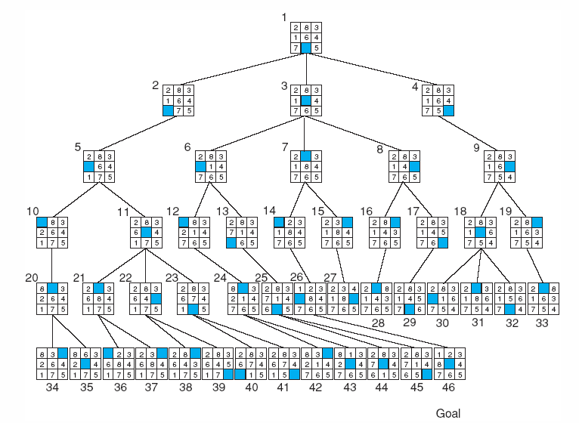
Breadth-first search of the 8-puzzle
←
↑
→
↓
Cannot move
blank downward
↑
Notes:
For larger versions of the n-puzzle, finding a solution is easy, but the problem of finding the shortest solution is NP-hard

Slide 46
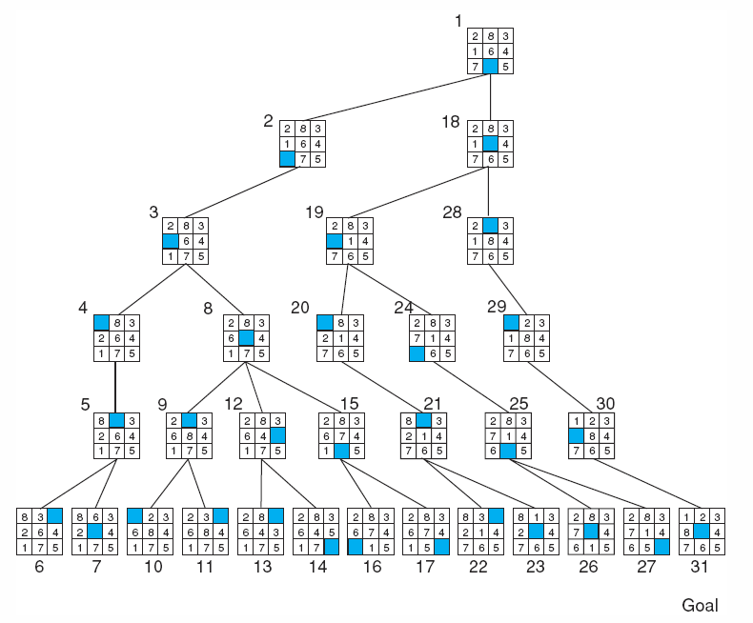
Depth-first search of 8-puzzle with a depth bound of 5
Breadth-first
took
46 nodes.

Slide 47
Summery of Today’s Lecture
Types of search Algorithms
Uninformed Search
Informed Search
Breadth-first searching
Depth-first search
Compare breadth first and depth first

